Slide 1


Customer Data Analysis and Improvement

Slide 2


1. AbdulRahman Hesham. 2. Mohamed Ibrahim. 3. Mohamed Ashraf. 4. Ahmed Mohamed.

Slide 3

Objectives
Enhance customer data management and analysis
Implement a robust database Perform
data analysis and build predictive models
Deploy machine learning models
Deliver interactive visualizations and dashboards

Slide 4



First Week
Week 1: Data Collection & Database Setup:
Source of Data:
The data used in this project was sourced from reputable platforms like GitHub and Kaggle, ensuring high-quality, real-world datasets.
Data Selection:
We selected relevant datasets that provide insights into customer behavior, product information, and order details to build a comprehensive database.
ERD Creation:
After analyzing the datasets, we designed an Entity-Relationship Diagram (ERD) to visually represent the data entities and their relationships.
Schema Design:
Based on the ERD, we created a detailed schema outlining the structure of the database, specifying the tables, columns, data types, and relationships.
Azure Deployment:
Once the schema was finalized, we deployed the database to Microsoft Azure, providing a scalable and secure environment for data storage and management.

Slide 5
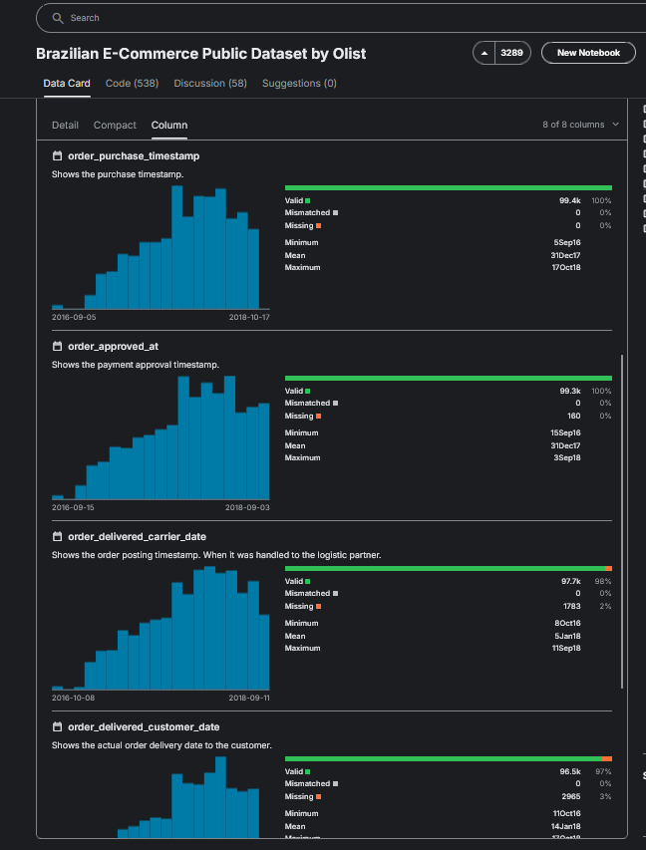
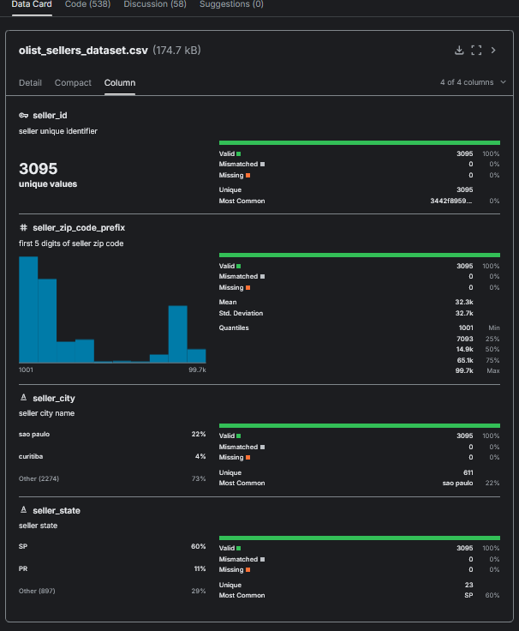
DATA

Slide 6


Slide 7
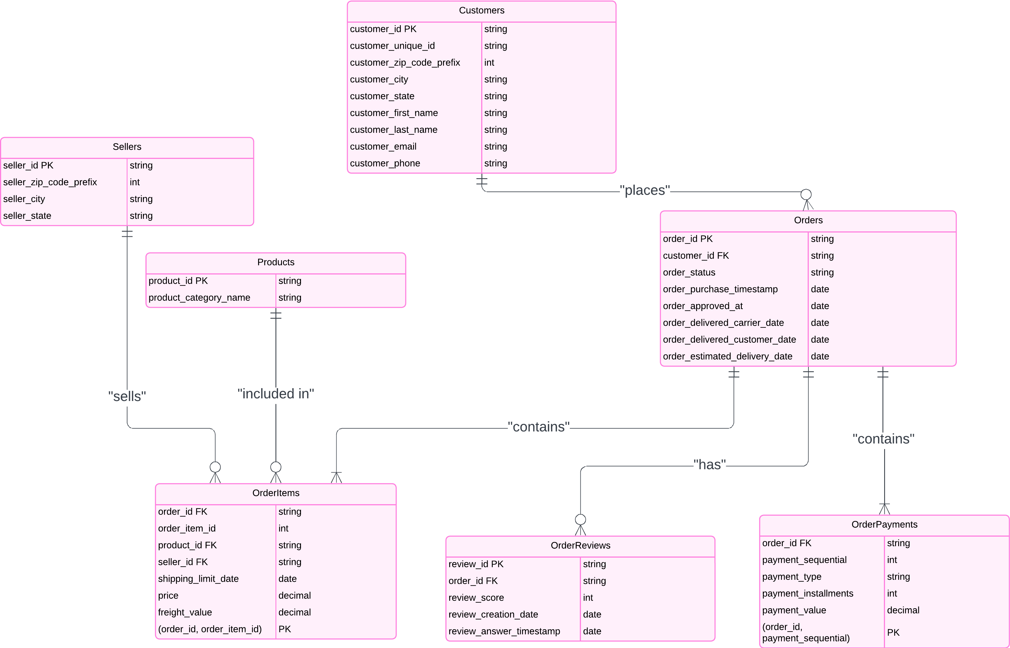
ERD

Slide 8
Second Week
Week 2: Data Cleaning, Analysis & Azure SQL Database Deployment
Data Cleaning:
Cleaned the dataset by handling missing values, removing duplicates, and correcting
data types to ensure data quality.
Data Analysis:
Performed preliminary data analysis to validate the integrity and consistency
of the cleaned data.
Azure SQL Deployment:
Deployed the SQL database in Azure usingSQL Server Management
Studio (SSMS) and SQL Wizard for efficient management and accessibility.

Slide 9
Data Cleaning
Issues Identified: The data contained 1,000 missing values, duplicates, and incorrect data types.
Null Handling: Missing values were either filled or removed based on context.
Duplicates Removed: Duplicate entries(2,000) were identified and deleted to ensure accuracy.
Data Type Adjustments: Columns with incorrect data types (e.g., strings instead of integers) were corrected.
Tools Used: We used NumPy, pandas, and Excel to cleanse and process
the data.
Final Check: After cleansing, we ensured the datasets were accurate and ready for analysis.

Slide 10
Feature Engineering
churn: Identified customers with one order as churned.
order_processing_time: Time between purchase and approval in hours.
shipping_delay: Time difference between actual delivery and estimated delivery.
actual_delivery_time: Time between purchase and actual delivery.
delivery_speed: Time between carrier delivery and customer delivery.
customer_order_frequency: Count of orders per customer.
customer_review_average: Average review score per customer.

Slide 11
Feature Engineering
customer_review_response_time: Time between review creation and response in hours.
product_popularity: Number of orders for each product.
seller_popularity: Number of orders per seller.
same_state: Binary indicator if the customer and seller are from the same state.
is_high_value_order: Binary indicator if the order value exceeds the 75th percentile.
product_avg_review_score: Average review score for each product.
seller_avg_review_score: Average review score for each seller.

Slide 12

Deploying Data with Azure SQL Database
Azure SQL Database Setup: Provisioned the database using Azure Portal.
Connected with SSMS: Established a secure connection to Azure SQL using SQL Server Management Studio (SSMS).
Schema Execution: Deployed the database schema by running SQL scripts in SSMS.
Data Import: Imported data using the SQL Server Import and Export Wizard, ensuring smooth data transfer.

Slide 13
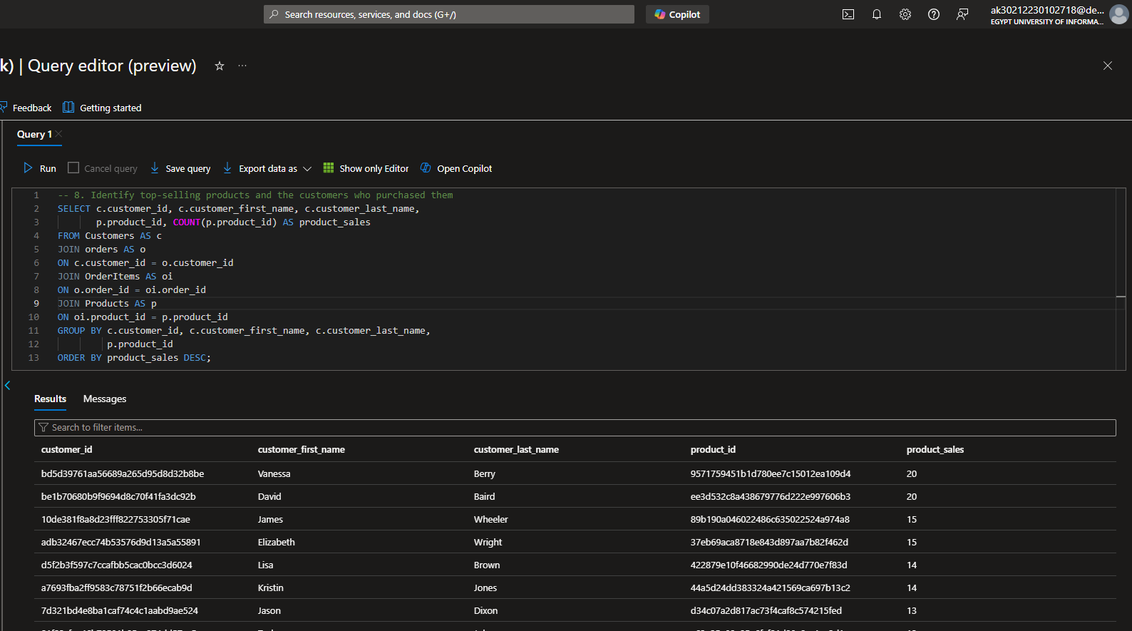
Verifying Data in Azure SQL Database

Slide 14
Third Week
Week 3: Power BI and Azure SQL Database Integration
1. Azure SQL Connection:
Connected Power BI to Azure SQL Database using Direct Query .
2. Snowflake Schema:
Designed a snowflake schema:
Optimized relationships to enhance query performance.
3. Review Analysis Dashboards:
Developed interactive dashboards to visualize:
4. Outcomes:
Gained insights into customer feedback, enabling informed decision-making for service improvements.
5. Exploratory Data Analysis:
Using Pandas.

Slide 15




Data EcoSystem

Slide 16
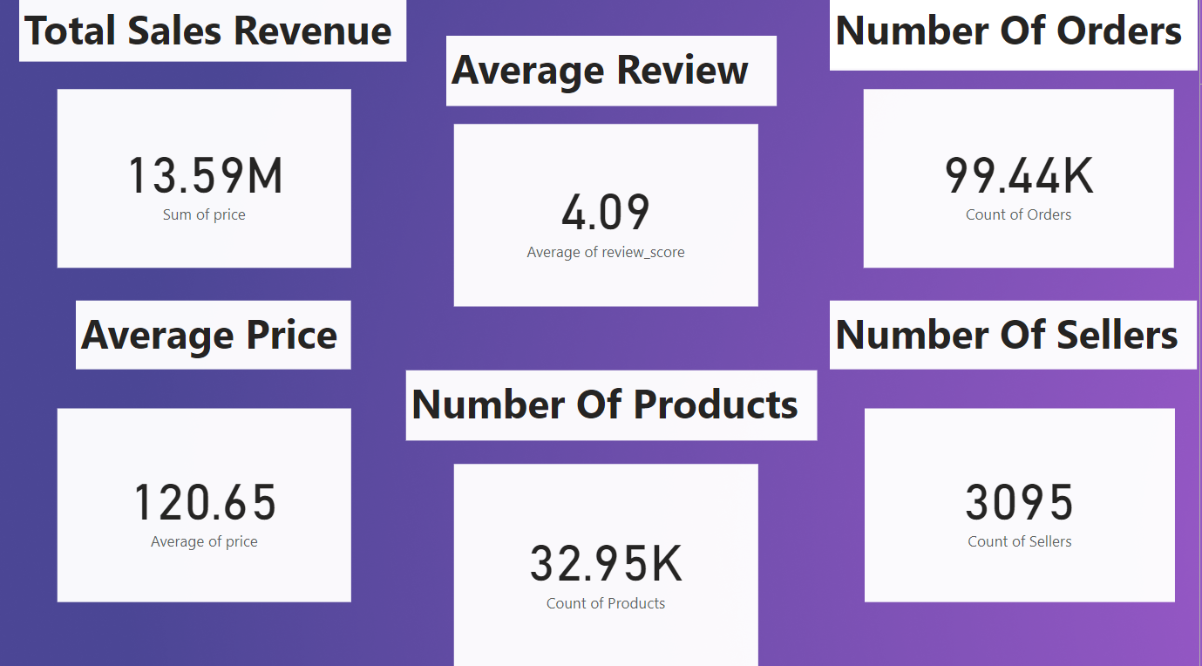

Slide 17
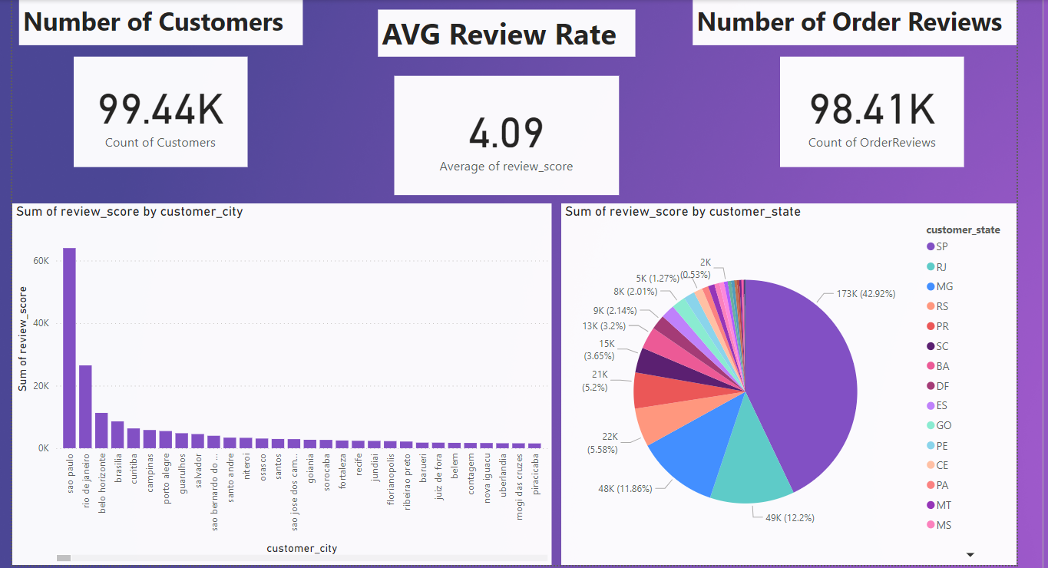

Slide 18
Review Analysis Dashboard
Number of Order Reviews:
98.41K total reviews submitted, suggesting a high engagement rate from customers.
Sum of Review Score by City (Bar Chart):
São Paulo leads with the highest review score (over 60K),
followed by Rio de Janeiro and other cities, highlighting key regions
with significant customer activity.
Sum of Review Score by State (Pie Chart):
São Paulo (SP) represents 42.92% of the total reviews,
followed by states like Rio de Janeiro (RJ) and Minas Gerais (MG).

Slide 19
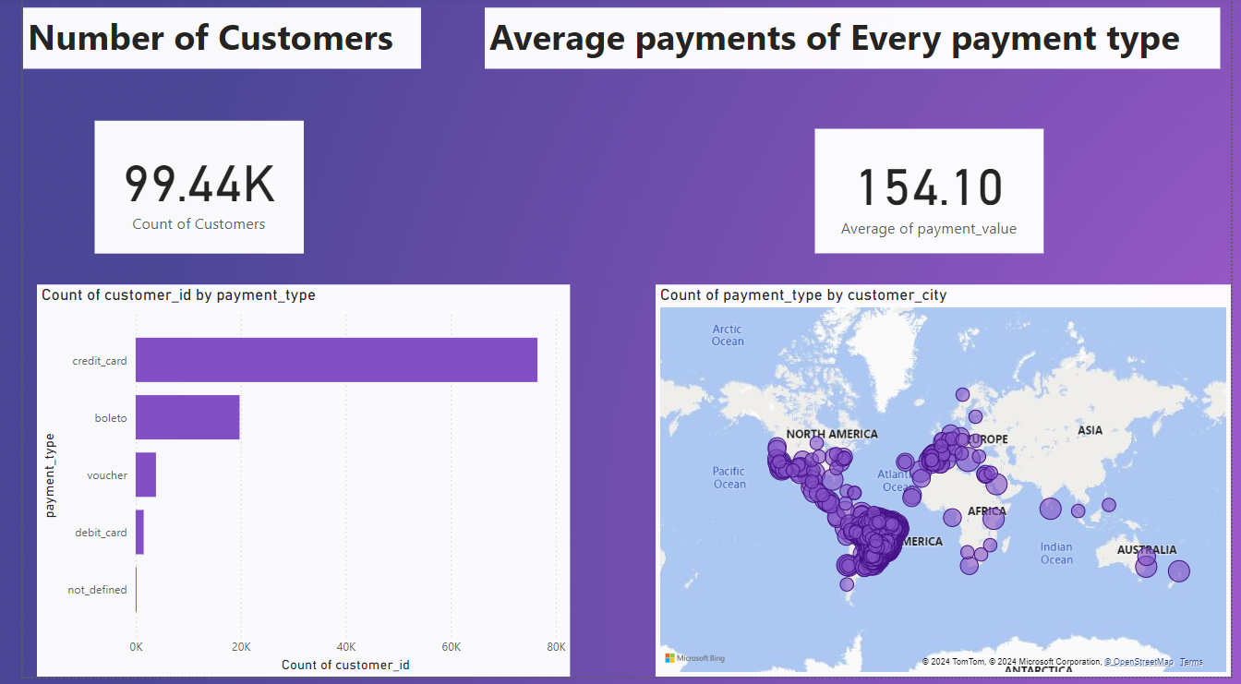

Slide 20
Review Analysis Dashboard
Average Payment Value:
The average payment value is 154.10, giving insight into typical transaction sizes.
Count of Customer ID by Payment Type (Bar Chart):
The majority of payments are made via credit card,
followed by boleto and voucher, showing customer payment preferences.
Count of Payment Type by City (Map Visualization):
Visual distribution of payment types across cities, showing
dense customer activity in the Americas and Europe,
with scattered activity in other regions like Asia and Australia.

Slide 21
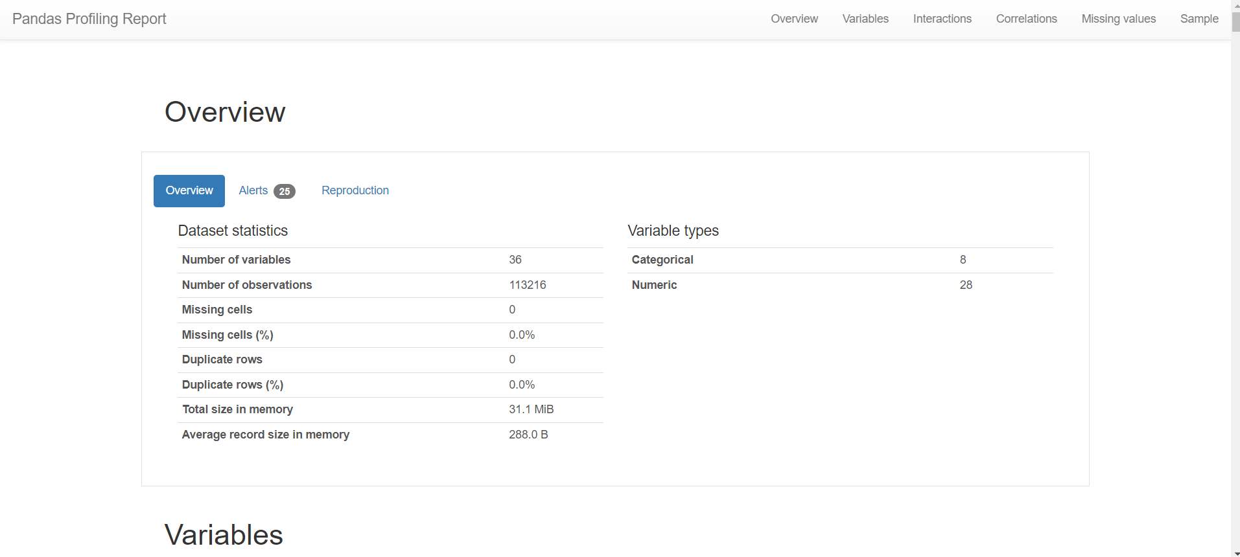
Exploratory Data Analysis
Used ydata_profiling (Pandas Profiling) to generate a profile report

Slide 22
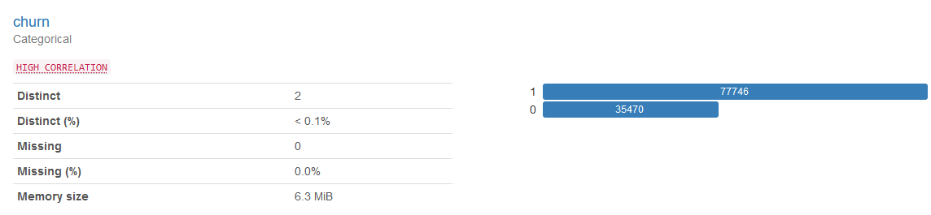
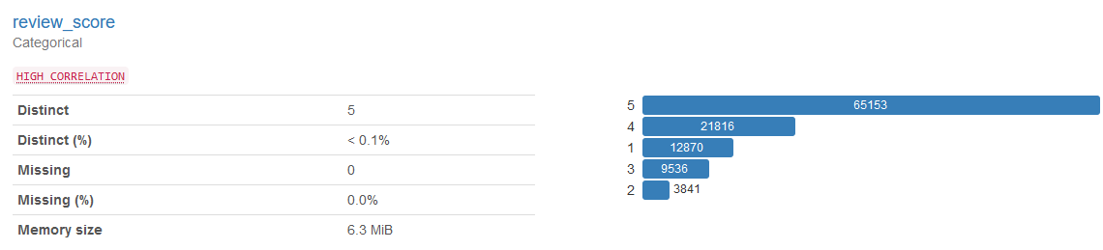
Exploratory Data Analysis
Shows useful insights about the data

Slide 23
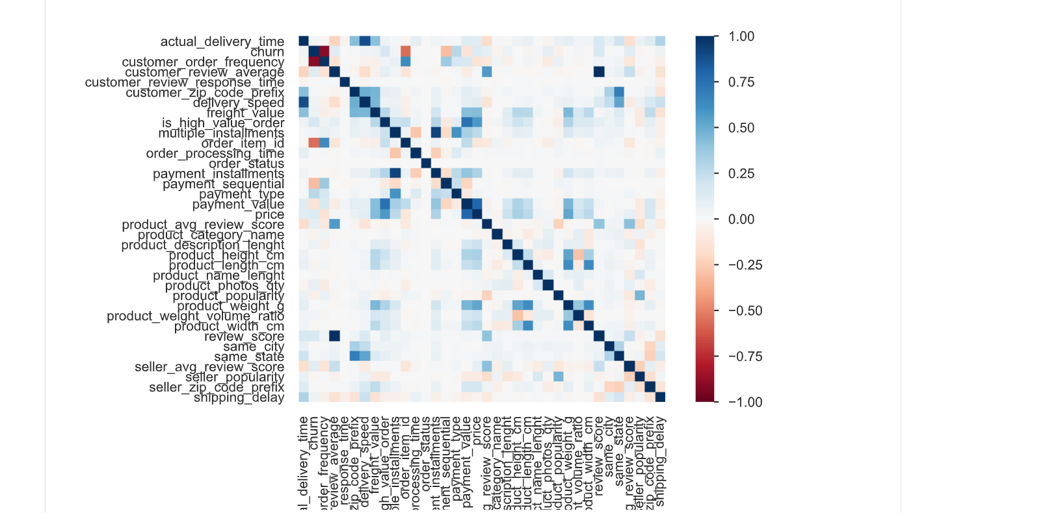
Exploratory Data Analysis

Slide 24
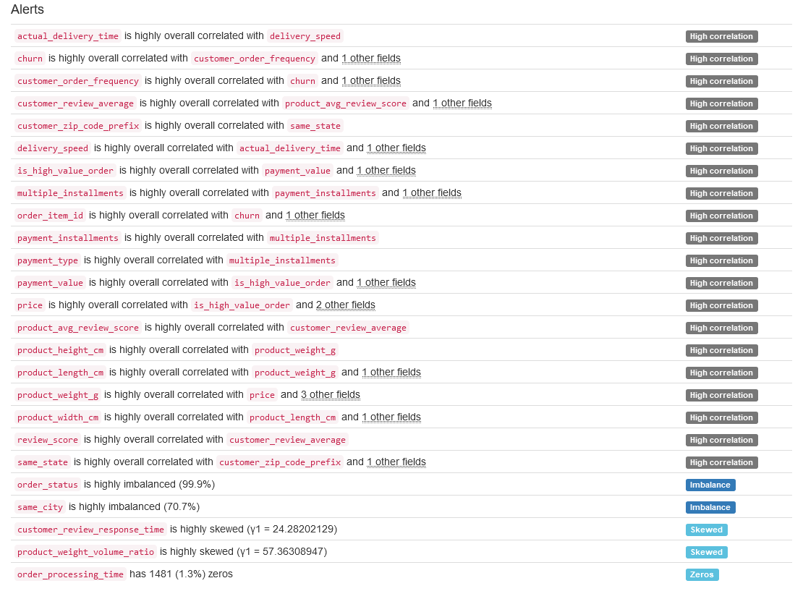
Exploratory Data Analysis

Slide 25
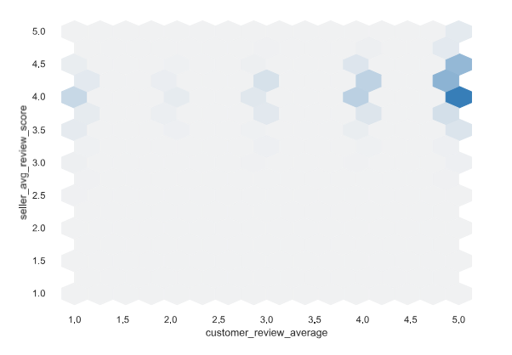
Exploratory Data Analysis

Slide 26
Fourth Week
Week 4: MLOps, Deployment, and Final Presentation
MLflow Setup:
Implemented MLflow for tracking machine learning experiments and model performance.
Model Deployment:
Deployed the trained machine learning models using Flask for a web-based application.
Predictions and Insights:
Deployed models predict customer churn and other key metrics based on data analysis.
Final Presentation:
Delivered final insights and presented an interactive web-based application for customer data predictions.

Slide 27
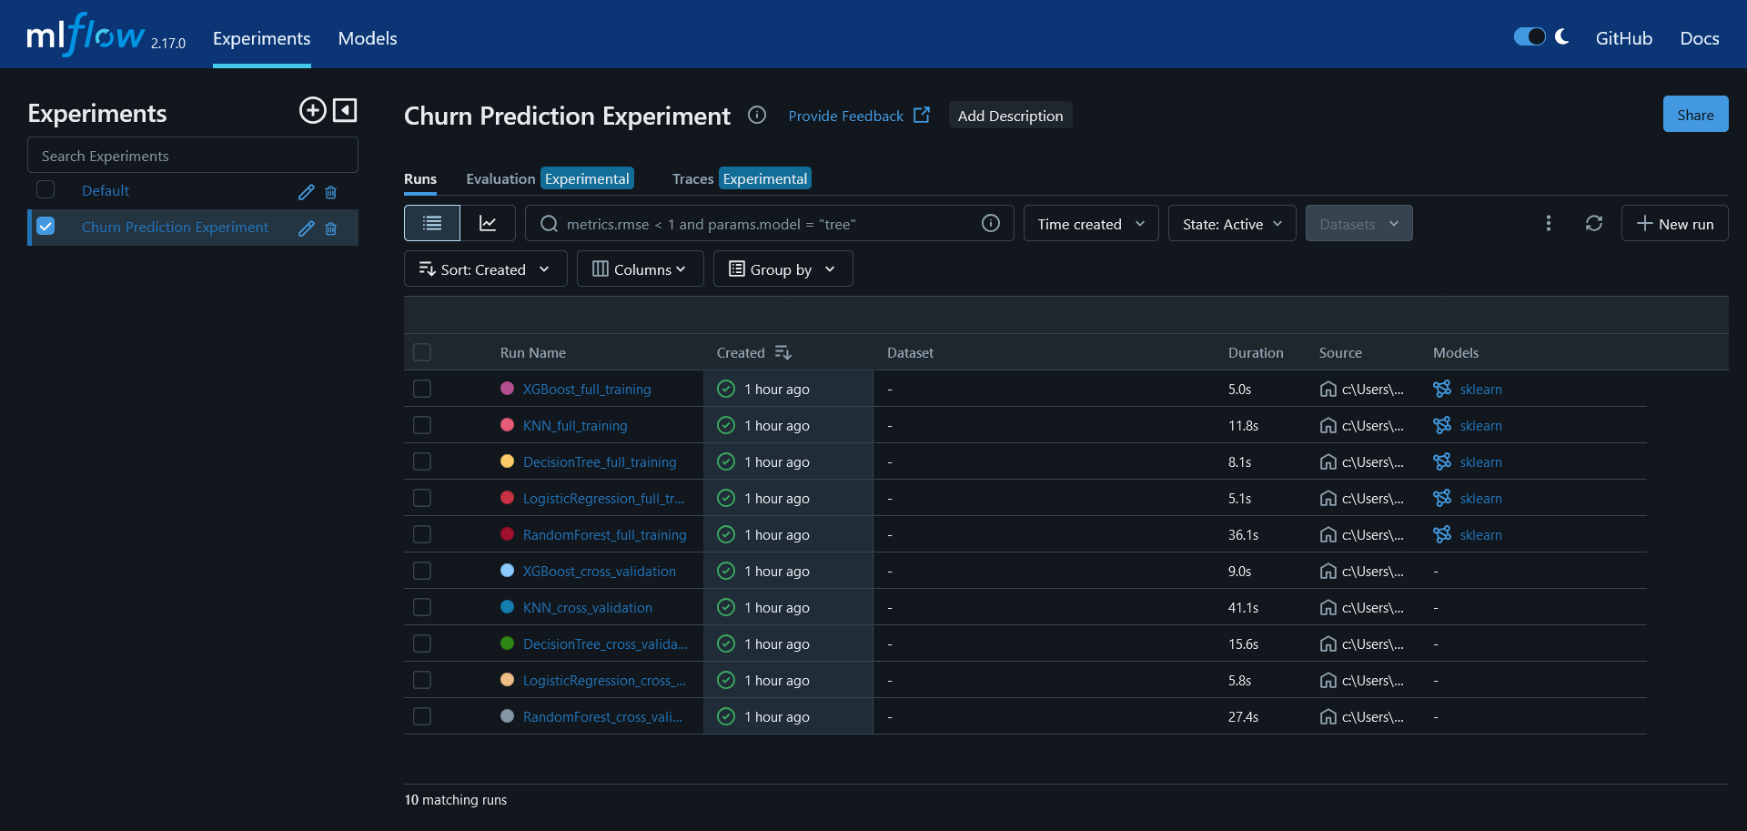
MLops

Slide 28
FULL TRAINING

Slide 29
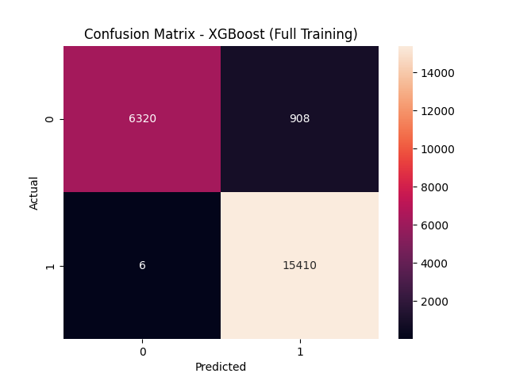
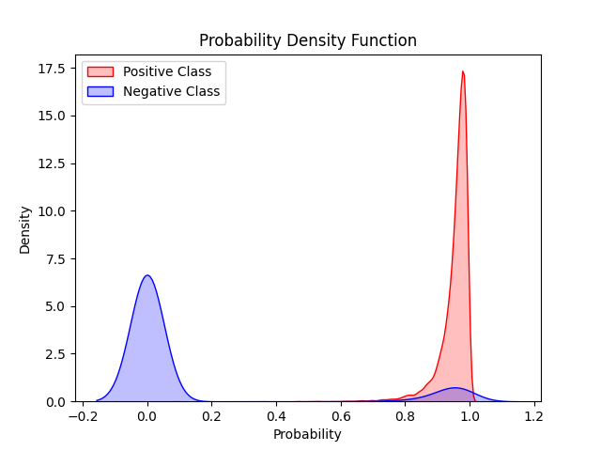
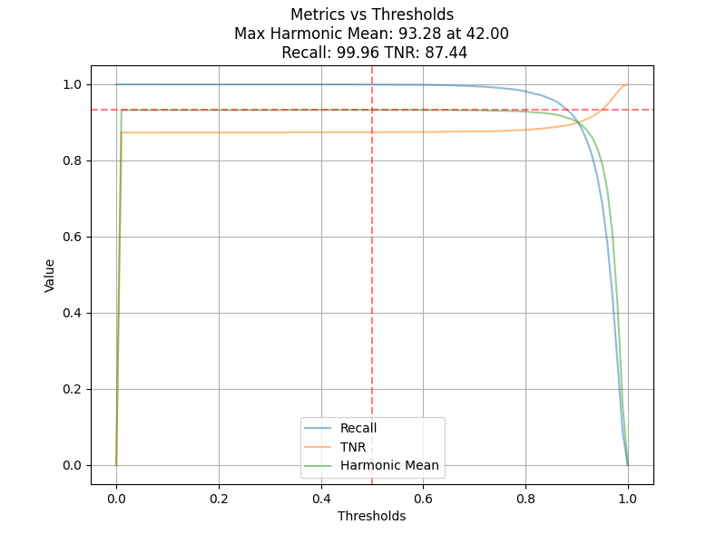
XGBoost_full_training

Slide 30
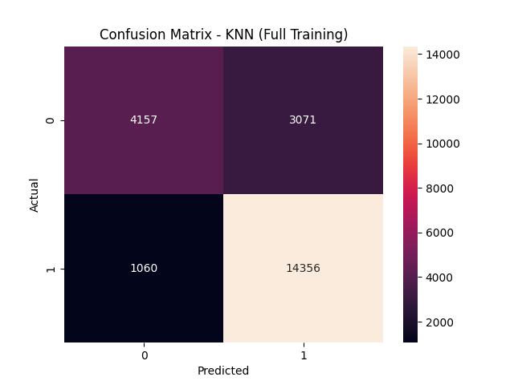
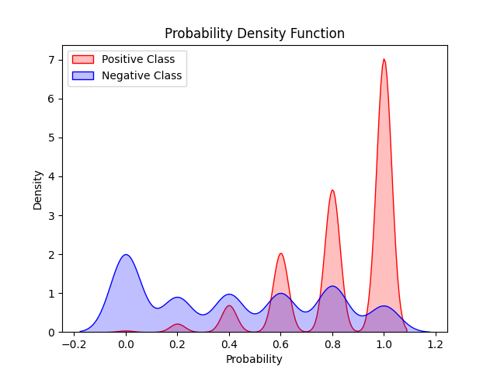
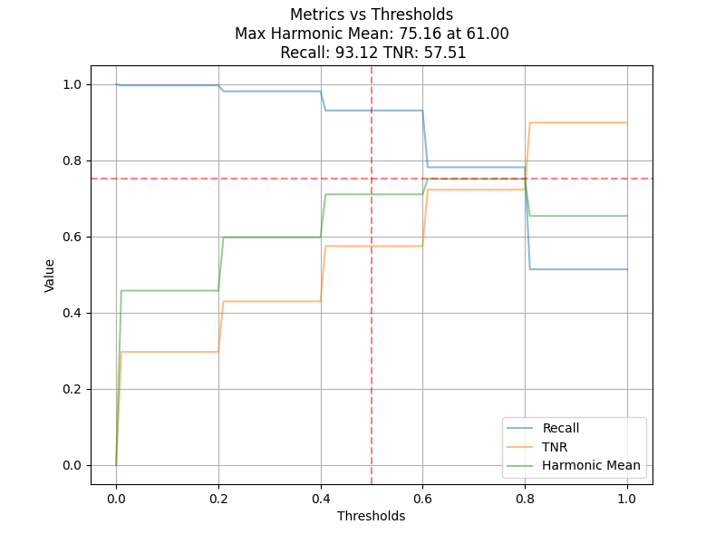
KNN_full_training

Slide 31

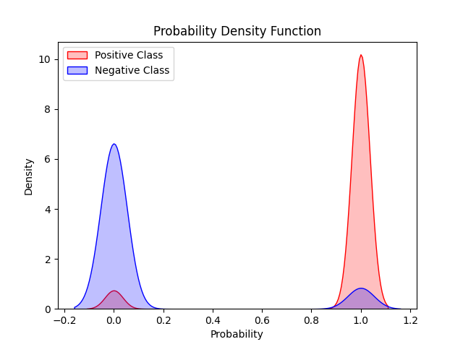
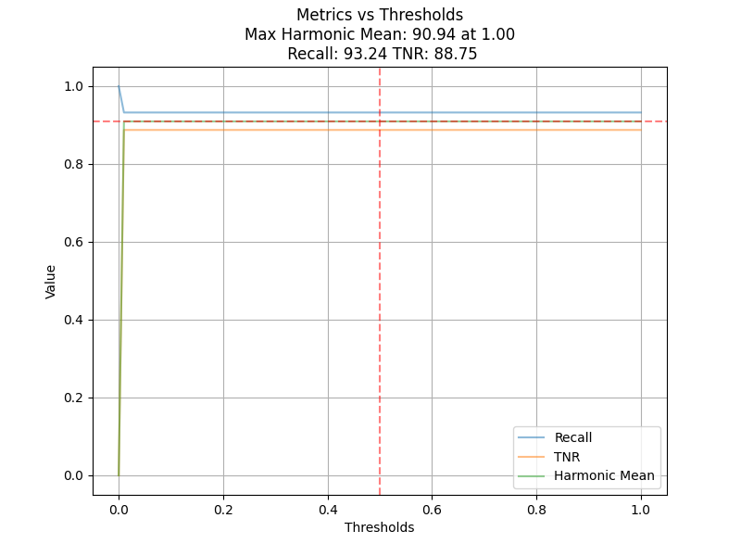
DecisionTree_full_training

Slide 32

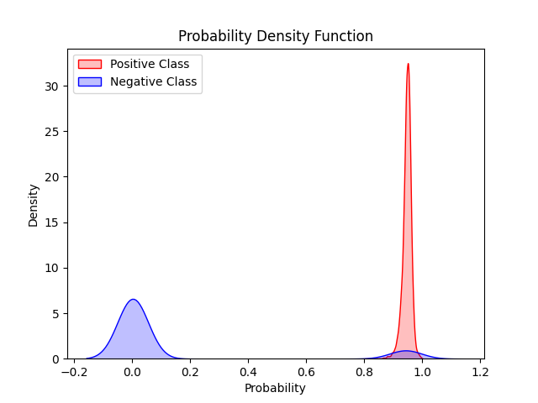
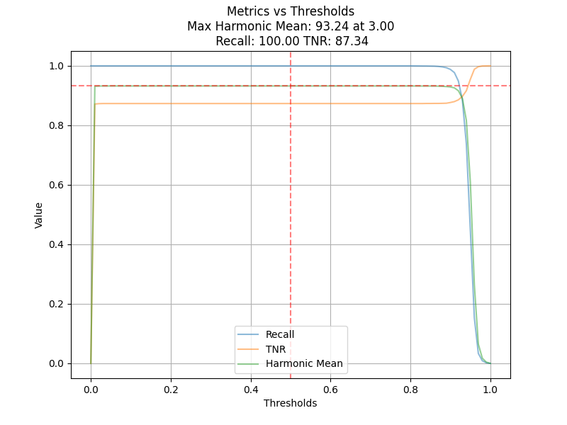
LogisticRegression_full_training

Slide 33

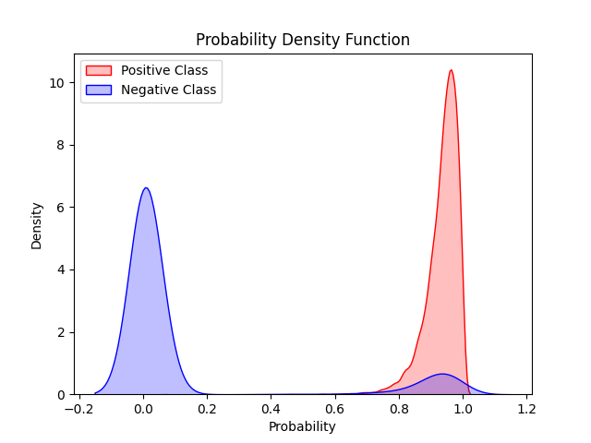
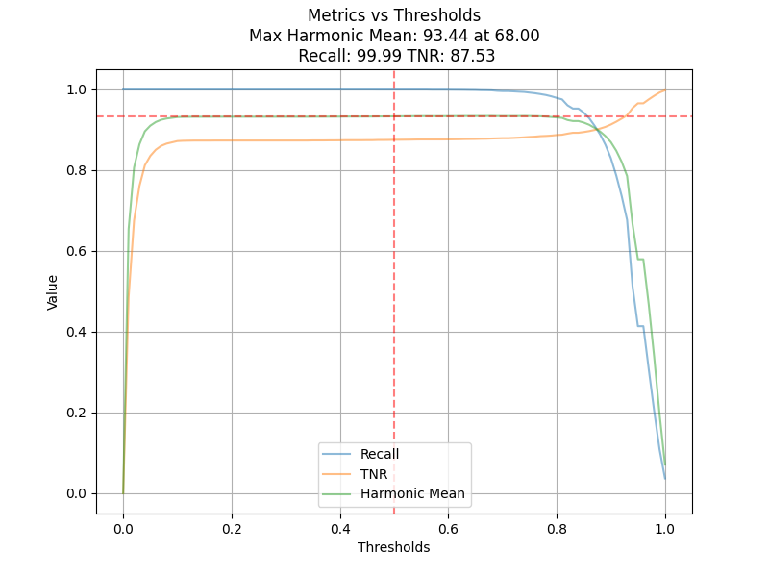
RandomForest_full_training

Slide 34
validation

Slide 35
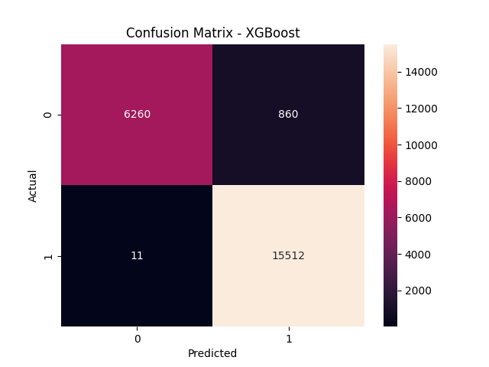
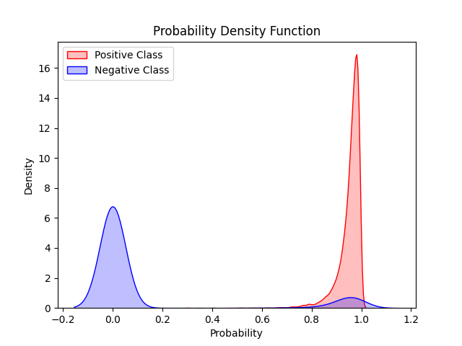
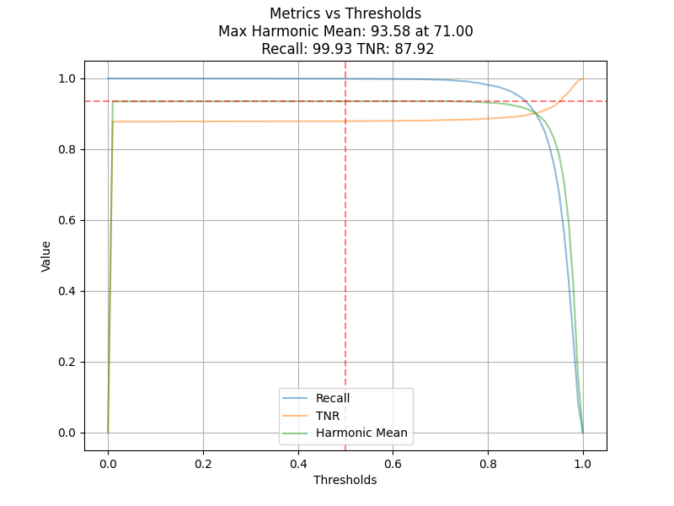
XGBoost_cross_validation

Slide 36
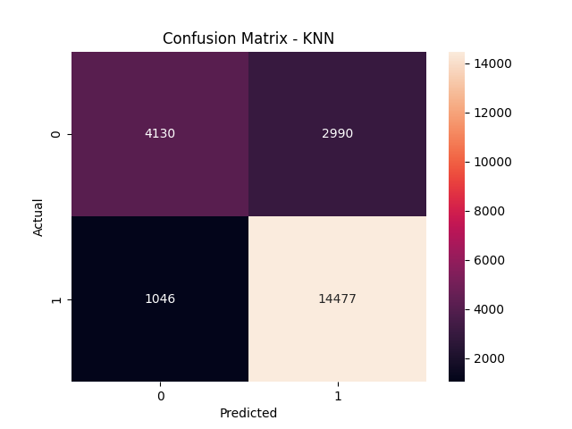

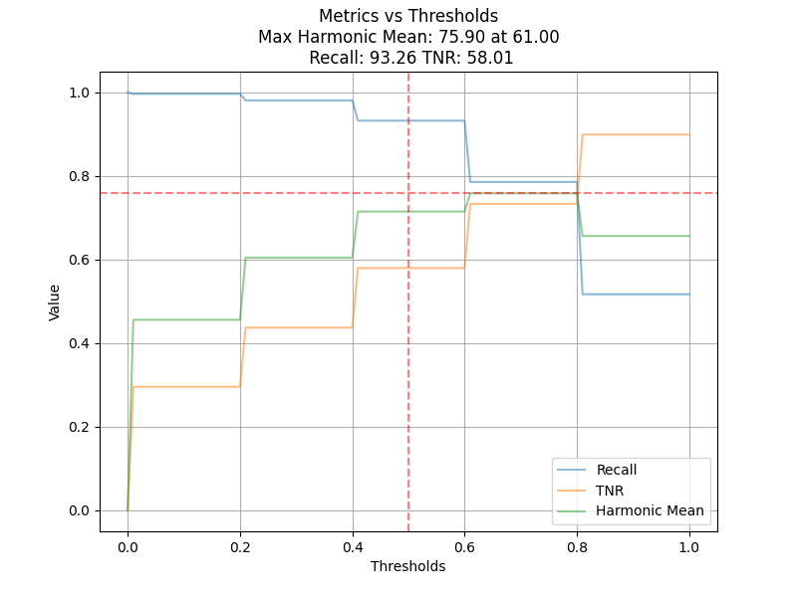
KNN_cross_validation

Slide 37

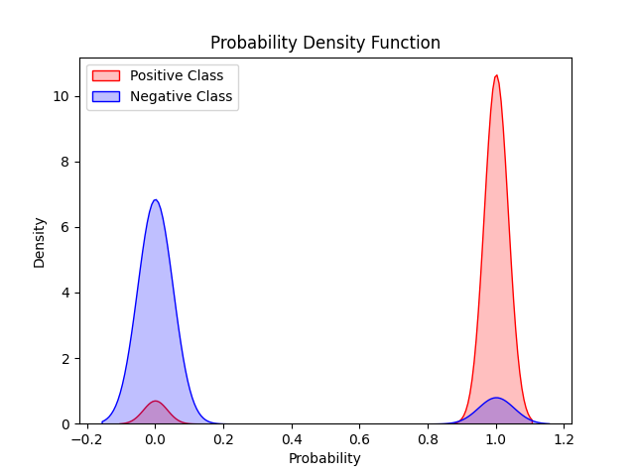

DecisionTree_cross_validation

Slide 38

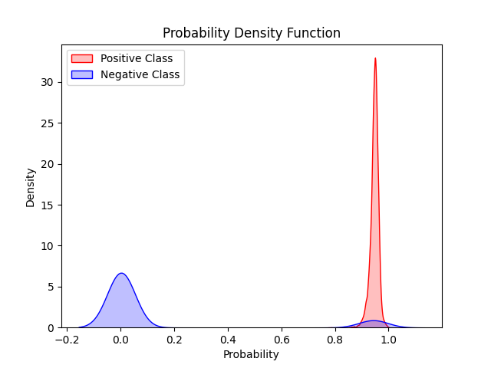

LogisticRegression_cross_validation

Slide 39

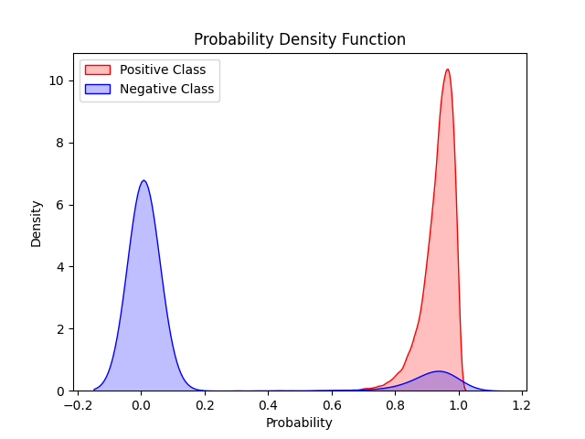

RandomForest_cross_validation

Slide 40
Predictive Modeling
Churn Model (Random Forest Classifier):
Accuracy: 96.3%
Recall: 99%
Precision: 94.9%
F1 Score: 97.4%
Review Model (Random Forest Classifier):
Accuracy: 96.4%
Class 1: Recall - 99.4%, Precision - 97.4%
Class 2: Recall - 99.8%, Precision - 99.8%
Class 3: Recall - 99.1%, Precision - 90.0%
Class 4: Recall - 29.6%, Precision - 93.5%
Class 5: Recall - 93.6%, Precision - 99.5%

Slide 41
Predictive Modeling
Sales Model Performance (Linear Regression)
Mean Squared Error (MSE): 0.0093
Root Mean Squared Error (RMSE): 0.0964
Mean Absolute Error (MAE): 0.0079
R² Score: 0.995
Sales Model Performance (XGboost)
Mean Squared Error (MSE): 0.009559
Root Mean Squared Error (RMSE): 0.097771
Mean Absolute Error (MAE): 0.00812
R² Score:0.994771

Slide 42
Predictive Modeling
Sales Model Performance (Randomforset)
Mean Squared Error (MSE): 0.008786
Root Mean Squared Error (RMSE): 0.093733
Mean Absolute Error (MAE): 0.006995
R² Score:0.995194
Churn Prediction & Review Prediction: Random Forest classifier performed well in predicting them.
Sales Prediction: Linear Regression had high predictive accuracy.

Slide 43
WEbPage

Slide 44
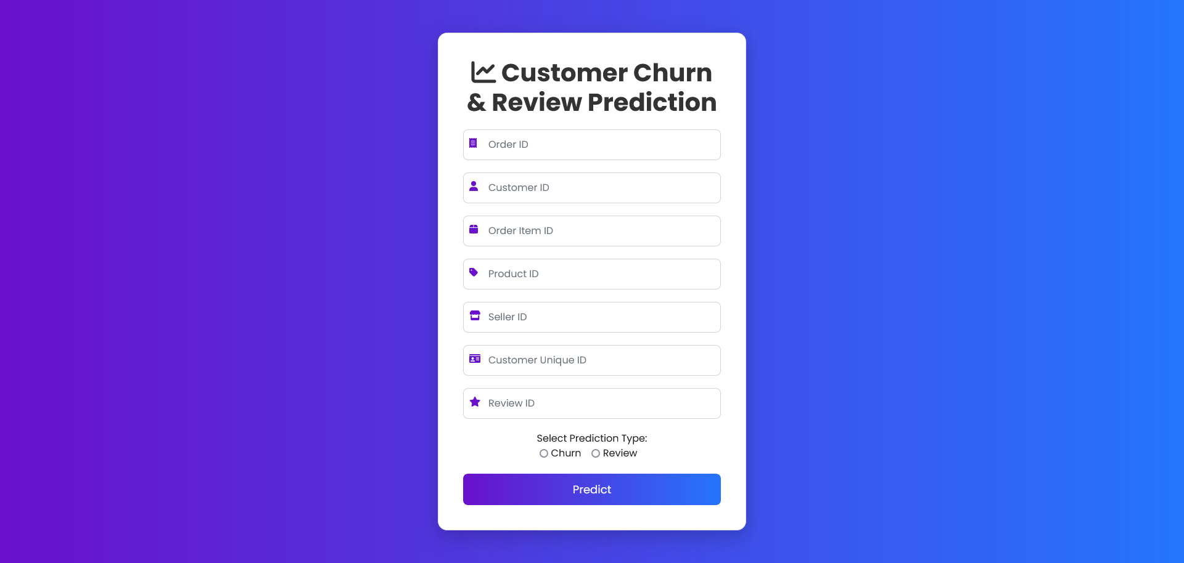
WebPage

Slide 45
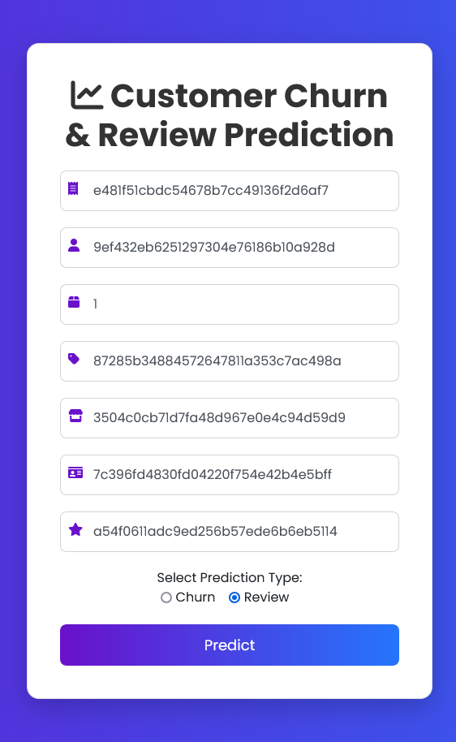
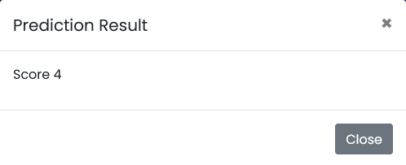
WebPage

Slide 46
Links
Kaggle dataset:
https://www.kaggle.com/datasets/olistbr/brazilian- ecommerce?select=olist_geolocation_dataset.csv
Webpage:
https://broccoli-gudtf6dkf2bsdxbm.uaenorth
-01.azurewebsites.net/

Slide 47

Thanks!
Do you have any questions?

